Slide 1
Duplicate MRN Analysis Project
Using Mockaroo, SQL, and Power BI to uncover the root causes of duplicate patient records

Slide 2
Understanding the Business Problem
What is an MRN?
Why is this important?
What can be done about this?
Duplicate Medical Record Numbers (MRNs) occur when a single patient is assigned multiple unique identifying numbers within a healthcare system, often due to data entry errors, name changes, or system mergers. These duplicates cause critical safety risks, including missed allergies, incorrect medications, and fragmented care histories.
Patient Safety: Inaccurate medical records can result in hidden or conflicting information
Cost Impact: Redundant testing and billing errors
Operational Drag: Staff spend significant time manually identifying and interpreting duplicate records instead of higher-value work
Data analysts can create visuals with collected data to reveal and analyze trends which can help with identifying the lead causes. These visuals can be created with platforms such as Power BI or Tableau, which can aid management in making informed business decisions.
Duplicate MRN Analysis Project • Ethan Dobbs • 2026

Slide 3
Project Objectives
Which facilities and service lines generate the most duplicate MRNs?
Which patient demographics are most affected?
What are the root causes driving duplication?
Duplicate MRN Analysis Project • Ethan Dobbs • 2026

Slide 4
Workflow
Creating Visuals and Polishing for Aesthetics
Visuals were created using DAX measures and columns in the 3 tables. A final polish was done to ensure that the report is easy to read, and that the styling theme was consistent throughout the entire report. A PDF version of the report was exported, and was converted into separate PNG files for convenience.
Generate synthetic data
10,000 rows across 19 columns of data were synthetically generated to simulate a realistic Centralized Healthcare Database (CHD), using Mockaroo. Constraints written in Ruby were added to provide realistic data, such as skewing over 60% of patients in the “Senior” age group.
DAX Formulas
Measures were written and compiled into a “_DAX” table, which centralizes all DAX formulas for better organization.
Organize and Clean Data
The main fact table was divided into 3 tables to avoid the use of unnecessary duplicate values. It was structured into a star schema, consisting of 1 fact table and 2 dimension tables.
Planning Stage
Each report page was given a name, purpose, and defined scope, with Power BI used to visualize the underlying data.
Duplicate MRN Analysis Project • Ethan Dobbs • 2026

Slide 5
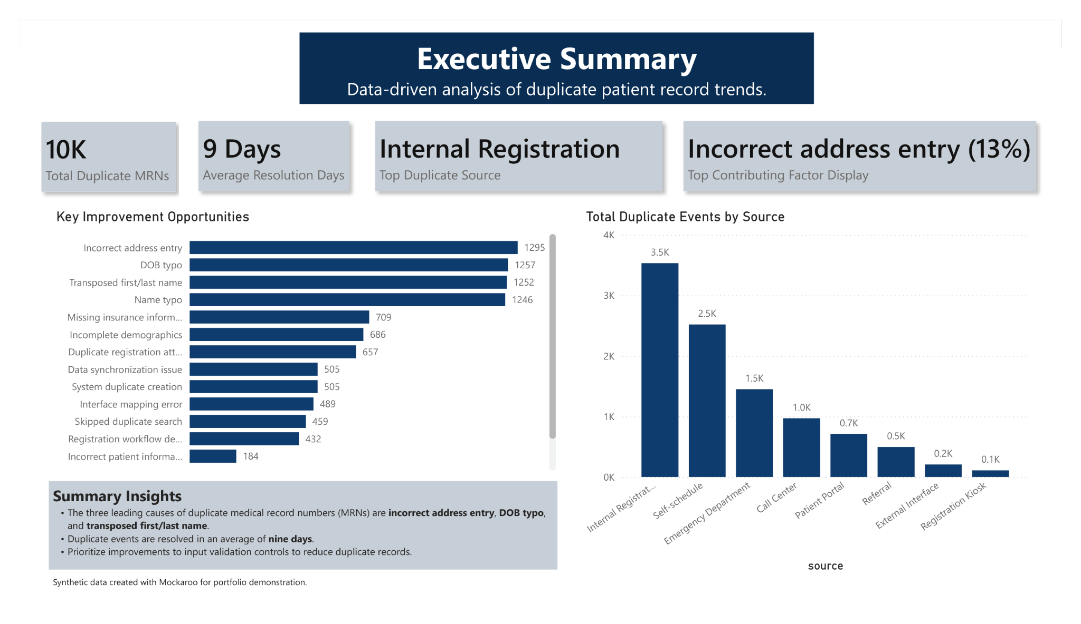
The ‘Executive Summary’ report page provides a high-level snapshot of duplicate MRN concentration
Sets the stage for deeper investigation into root causes
Duplicate MRN Analysis Project • Ethan Dobbs • 2026

Slide 6
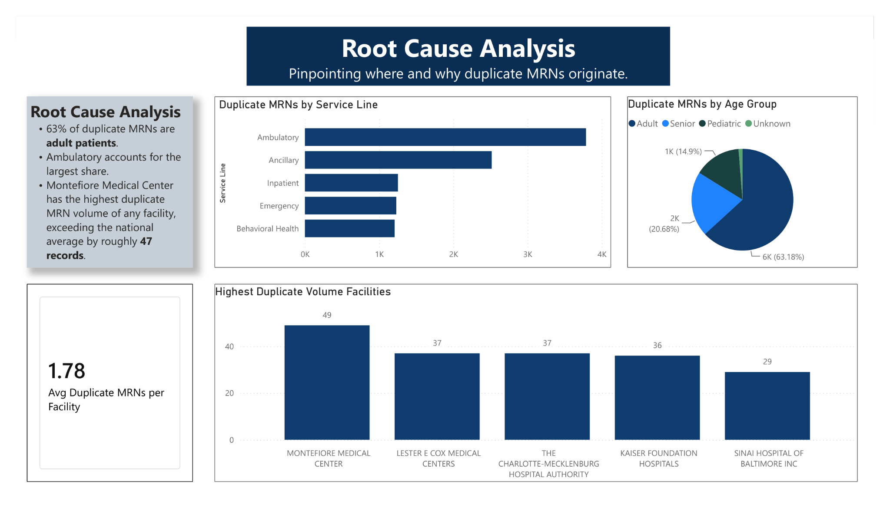
The ‘Root Cause Analysis’ page shows a detailed view of underlying causes
Helps identify the location and source of the causes
Establishes the average duplicate MRNs per facility as a benchmark for comparison against the highest-volume facilities.
Duplicate MRN Analysis Project • Ethan Dobbs • 2026

Slide 7
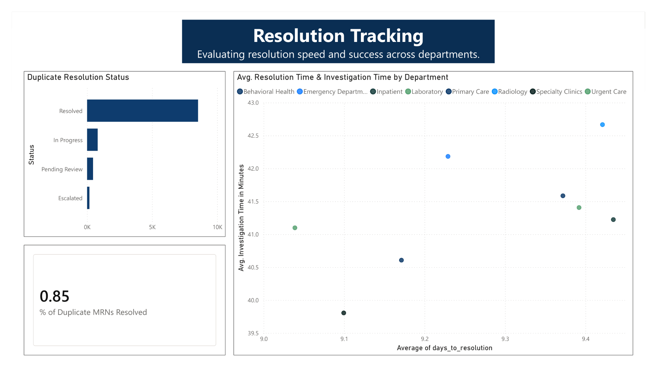
Provides a benchmark % resolved rate to gauge overall process performance.
Compares investigation time against resolution time by department to flag efficiency gaps
Duplicate MRN Analysis Project • Ethan Dobbs • 2026

Slide 8
Actionable Recommendations
Prioritize High-Volume Facilities
Invest in automated patient-matching software
Set department-level resolution targets
Focus process improvements on outliers like Montefiore Medical Center
Flag likely duplicate patients in Ambulatory and Ancillary before a new MRN is even created
Establish time-to-resolve benchmarks for slower departments and reallocate staff or tools to close the gap
Improve Input Validation
Implement stricter data entry controls and real-time duplicate-checking at registration to catch inconsistencies (name variations, DOB mismatches, address changes) before they generate a new MRN
Duplicate MRN Analysis Project • Ethan Dobbs • 2026

Slide 9
Questions / Thank You
Duplicate MRN Analysis Project • Ethan Dobbs • 2026

